Slide 1
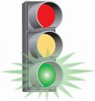
Lab 5b: Traffic Stoplight

Slide 2
Lab 5b: Traffic Stoplight
Program a pedestrian traffic light for a street with a crosswalk.
Use the large red, yellow, and green LEDs for the car traffic and the smaller red and green LEDs along with the orange LED for pedestrians.
Four traffic light states (Green, Yellow, Red, and Pedestrian) are used to allow pedestrians to safely cross a busy street as well as calm the traffic.

Slide 3
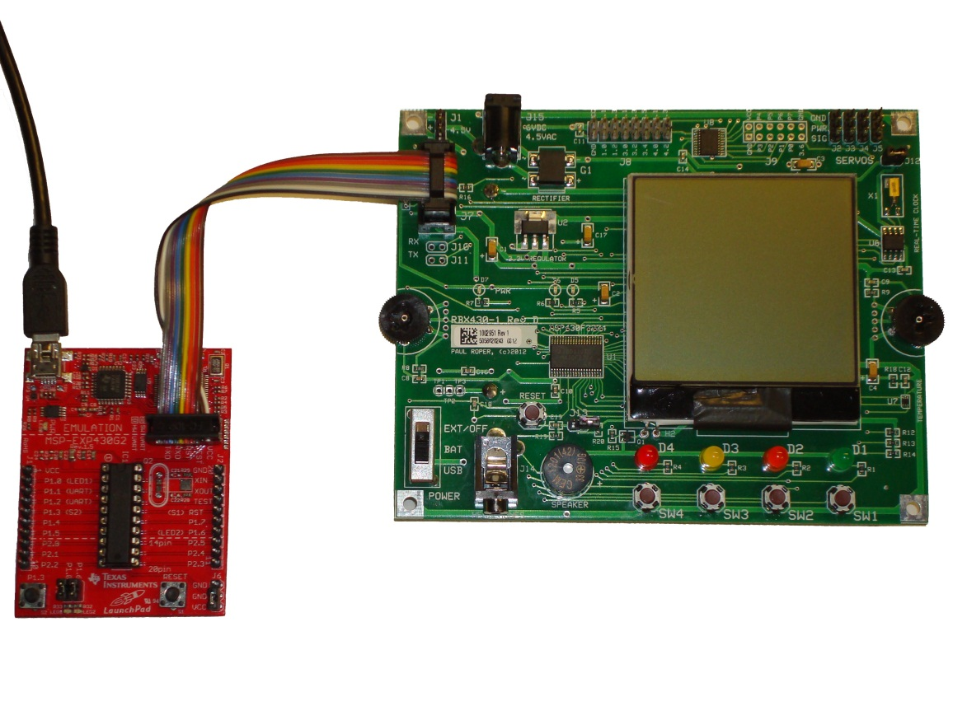
RBX430-1 Hookups
Pedestrian
Walk LED
Pedestrian
Stop LED
Pedestrian
Waiting LED
Car Stop LED
Car Go LED
Car Caution LED

Slide 4
Traffic Light Patterns
Turn on green car and pedestrian red LED for 20 seconds.
Turn on yellow car LED for 5 seconds.
No pedestrian signal.
Turn on red car LED for 5 seconds.
Green |  |  |  |  |  |  |  |  |  |  |  |  |  |  |  |  |  |  |  | Yellow |  |  |  |  | Red
Green (10 seconds minimum) |  |  |  |  |  |  |  |  |  |  |  |  |  |  |  |  |  |  |  | Yellow |  |  |  |  | Pedestrian
Car
Red pedestrian LED on during Normal cycle.
Ped
Normal traffic light cycle time should be 30 seconds (± 1/2 second).
Turn on red car LED and turn off pedestrian red and orange LEDs. Turn on pedestrian green LED for 5 seconds, toggle every second for 6 seconds, and then rapidly toggle every 1/5 second for 4 seconds.
Turn on green car and pedestrian red LED for 20 seconds. BONUS: If pedestrian LED after 10 seconds, move to yellow.
Turn on yellow car LED for 5 seconds. Move to pedestrian sequence.
Car
Ped
Pedestrian traffic light cycle time should be 30-40 seconds (depending on when button is pressed).

Slide 5
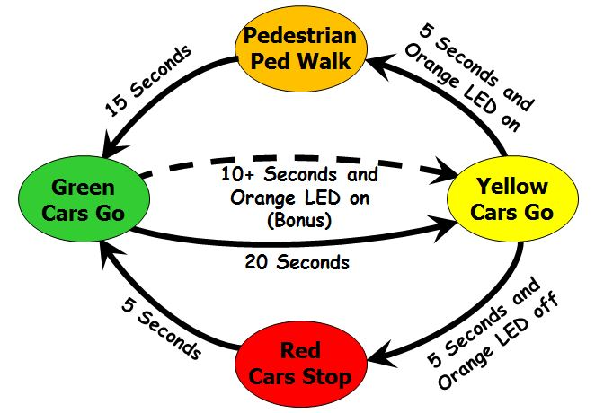
Traffic States/LEDs
Normal Cycle (1-3) = 30 seconds
Pedestrian Cycle (1, 2, 4) = 40 seconds
 |  | Car LEDs (Large) |  |  |  | Pedestrian LEDs (Small)
State | Time | Green | Orange | Yellow | Red | Green | Red
1 = GREEN | 20s | On | On/Off | Off | Off | Off | On
2 = YELLOW | 5s | Off | On/Off | On | Off | Off | On
3 = RED | 5s | Off | On/Off | Off | On | Off | On
4a = PEDESTRIAN | 5s | Off | On/Off | Off | On | ON | Off
4b = PEDESTRIAN | 6 × 1s | Off | On/Off | Off | On | Blink | Off
4c = PEDESTRIAN | 20 × 1/5s | Off | On/Off | Off | On | Blink | Off

Slide 6
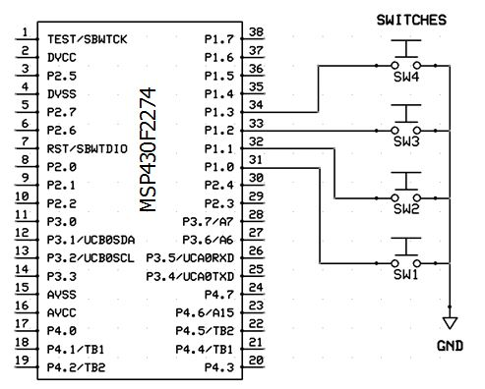
Button Inputs
Polling
Interrupts
bic.b #0x0f,&P1DIR ; set P1.0-3 as input
bis.b #0x0f,&P1OUT ; select pull-up
bis.b #0x0f,&P1REN ; enable pull-ups on P1.0-3
mov.b &P1IN,r13 ; sample buttons (0 => pressed)
and.b #0x0f,r13 ; mask least significant nybble
xor.b #0x0f,r13 ; button pressed?
jeq off ; n
bis.b #0x01,&P4OUT ; y, turn on green LED
off:
bic.b #0x0f,&P1SEL ; select GPIO
bic.b #0x0f,&P1DIR ; configure P1.0-3 as Inputs
bis.b #0x0f,&P1OUT ; use pull-ups
bis.b #0x0f,&P1REN ; enable pull-ups
bis.b #0x0f,&P1IES ; trigger on high to low transition
bis.b #0x0f,&P1IE ; P1.0-3 interrupt enabled
bic.b #0x0f,&P1IFG ; P1.0-3 IFG cleared
;---------Port 1 ISR----------------------------------------------
P1_ISR: bic.b #0x0f,&P1IFG ; clear P1.0-3 Interrupt Flag
bis.b #0x01,&P4OUT ; turn on green LED
reti
.sect ".int02" ; P1 interrupt vector
.word P1_ISR

Slide 7
Traffic Light Algorithm
Turn the large green car LED and small red pedestrian LED on for 20 seconds.
Turn off the large green car LED and turn on the yellow car LED for 5 seconds. If the orange LED is off, move to the red state by turning the yellow car LED off and the red car LED on for 5 seconds.
Else, turn the orange and small red pedestrian LEDs off and small green pedestrian LED and red car LED on. After 5 seconds, toggle small green LED on and off for 6 seconds at 1 second intervals. Finish by toggling small green LED on and off for 4 seconds at 1/5 second intervals.
Repeat the traffic stoplight cycle.
BONUS VARIATION:
Immediately move from green state to yellow state if the orange LED is on and at least 10 seconds has expired.

Slide 8
Traffic Lab Requirements
1 point Your traffic stoplight program source code contains header comments that include your name and a declaration that the completed assignment is your own work.
1 point The assembler directive .equ is used to define all delay counts and constants.
2 points All software timing delays are implemented using an assembly subroutine that delays in 1/10 second increments. All subroutines are implemented using a callee-save protocol.
4 points Your traffic stoplight machine correctly implements the traffic algorithm.
1 point Pressing any button at any time turns on the orange LED. The pedestrian sequence only occurs at the end of the yellow state and the orange LED is on (within 1/10 second.)
1 point The total traffic light cycle time (without a button press) is 30 seconds with less than a 1/2 second error.

Slide 9
Traffic Lab Bonus
+1 point Passed off with a TA at least one day early. (No timestamps please!)
+1 point If the orange pedestrian LED is on and at least 10 seconds has expired in the Green State, immediately move to Yellow State.
+1 point The number of 1/10 second delays is passed to the timing subroutine on the stack.
+1 point Interrupts are used to respond to a button being pressed rather than polling. The orange LED holds the state of the pedestrian request to cross the street.
-1 point For each school day late. (Timestamps may be used to verify completion time.)

Slide 10
Steps to Success!
Program the Green/Red states using a 1/10 second, callee-save delay subroutine. Test.
Add the Yellow state to complete a normal cycle. Test.
Modify your delay subroutine to continuously sample the switches. Turn on the orange LED when any switch is pressed. (Note: you will need to adjust your delay subroutine constants to compensate for the new instructions.) Test.
At the end of the Yellow state, jump to a Pedestrian state if the orange LED is on. Program a simple Pedestrian state with the small green LED and large red LED on for 5 seconds. Test.
Finally, finish the Pedestrian state with the small green LED toggling on and off at 1 second intervals for 6 seconds, following by the small green LED rapidly toggling on and off for 4 seconds at 1/5 second intervals.
Work on bonus material AFTER completing the lab requirements!

Slide 11
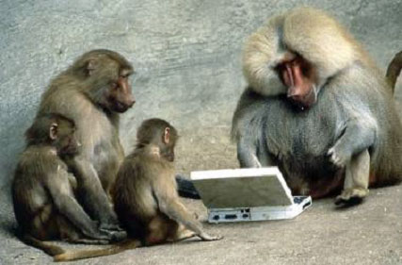

Slide 12
Traffic Light Algorithm
Turn the large green car LED and small red pedestrian LED on for 20 seconds.
Turn off the large green car LED and turn on the yellow car LED for 5 seconds. If the orange LED is off, move to the red state by turning the yellow car LED off and the red car LED on for 5 seconds.
Else, turn the orange and small red pedestrian LEDs off and small green pedestrian LED and red car LED on. After 5 seconds, toggle small green LED on and off for 6 seconds at 1 second intervals. Finish by toggling small green LED on and off for 4 seconds at 1/5 second intervals.
Repeat the traffic stoplight cycle.
BONUS VARIATION:
Number of 1/10 delays is passed to the delay subroutine on the stack.
Interrupts replace polling to respond to a switch (orange LED).
Immediately move from green state to yellow state if orange LED is on and at least 10 seconds has expired.

Slide 13
Traffic Light States
Pedestrian
Ped Walk
5 Seconds and
Orange LED on
15 Seconds
Green
Cars Go
10+ Seconds and
Orange LED on
(Bonus)
Yellow
Cars Go
20 Seconds
5 Seconds
5 Seconds and
Orange LED off
Red
Cars Stop

Slide 14
Traffic Light States
Orange
Ped Walk
11
5 Seconds
15 Seconds
5 Seconds
and Orange
10 Seconds
15 Seconds
Orange
Green
Cars Go
00
10+ Seconds
And Orange
Yellow
Cars Go
01
20 Seconds
5 Seconds
5 Seconds
and NO Orange
Red
Cars Stop
10

Slide 15
Traffic Light Patterns
Turn on green car and pedestrian red LED for 20 seconds.
Turn on yellow car LED for 5 seconds.
No pedestrian signal.
Turn on red car LED for 5 seconds.
Green |  |  |  |  |  |  |  |  |  |  |  |  |  |  |  |  |  |  |  | Yellow |  |  |  |  | Red
Car
Ped
Normal traffic light cycle time should be 30 seconds
(± 1/2 second).
Pedestrian traffic light cycle time should be 30-40 seconds
(depending on when button is pressed).
Green (10 seconds minimum) |  |  |  |  |  |  |  |  |  |  |  |  |  |  |  |  |  |  |  | Yellow |  |  |  |  | Pedestrian
Car
Ped
Turn on green car and pedestrian red LED for 10 seconds minimum. If pedestrian signal after 10 seconds, move to yellow.
Turn on yellow car LED for 5 seconds. Move to pedestrian sequence.
Turn on red car LED and turn off orange LED. Turn on small green LED for 5 seconds, toggle every second for 6 seconds, and rapidly toggle every 1/5 second for 4 seconds.

Slide 16
Traffic Light Patterns
Turn on green car and pedestrian red LED for 20 seconds.
Turn on yellow car LED for 5 seconds.
No pedestrian signal.
Turn on red car LED for 5 seconds.
Green |  |  |  |  |  |  |  |  |  |  |  |  |  |  |  |  |  |  |  | Yellow |  |  |  |  | Red
Normal traffic light cycle time should be 30 seconds
(± 1/2 second).
Pedestrian traffic light cycle time should be 30-40 seconds
(depending on when button is pressed).
Green (10 seconds minimum) |  |  |  |  |  |  |  |  |  |  |  |  |  |  |  |  |  |  |  | Yellow |  |  |  |  | Pedestrian
Turn on green car and pedestrian red LED for 10 seconds minimum. If pedestrian signal after 10 seconds, move to yellow.
Turn on yellow car LED for 5 seconds. Move to pedestrian sequence.
Turn on red car LED and turn off orange LED. Turn on small green LED for 5 seconds, toggle every second for 6 seconds, and rapidly toggle every 1/5 second for 4 seconds.

Slide 17
Pedestrian Cycle
Pedestrian traffic light cycle time should be 30-40 seconds (depending on when button is pressed).
Green (10 seconds minimum) |  |  |  |  |  |  |  |  |  |  |  |  |  |  |  |  |  |  |  | Yellow |  |  |  |  | Red / Pedestrian Green
Turn on green car and pedestrian red LED for 10 seconds minimum. If pedestrian signal after 10 seconds, move to yellow.
Turn on yellow car LED for 5 seconds. Move to pedestrian sequence.
Turn on red car LED and turn off orange LED. Turn on small green LED for 5 seconds, toggle every second for 6 seconds, and rapidly toggle every 1/5 second for 4 seconds.

Slide 18
Traffic Light Patterns
Normal traffic light cycle time should be 30 seconds
(± 1/2 second).
Green |  |  |  |  |  |  |  |  |  |  |  |  |  |  |  |  |  |  |  | Yellow |  |  |  |  | Red
Car
Red pedestrian LED on during Normal cycle.
Ped
Turn on green car and pedestrian red LED for 20 seconds.
Turn on yellow car LED for 5 seconds.
No pedestrian signal.
Turn on red car LED for 5 seconds.
Pedestrian traffic light cycle time should be 30-40 seconds
(depending on when button is pressed).
Green (10 seconds minimum) |  |  |  |  |  |  |  |  |  |  |  |  |  |  |  |  |  |  |  | Yellow |  |  |  |  | Pedestrian
Car
Ped
Turn on green car and pedestrian red LED for 10 seconds minimum. If pedestrian (orange LED) after 10 seconds, move to yellow.
Turn on yellow car LED for 5 seconds. Move to pedestrian sequence.
Turn on red car LED and turn off pedestrian red and orange LEDs. Turn on pedestrian green LED for 5 seconds, toggle every second for 6 seconds, and then rapidly toggle every 1/5 second for 4 seconds.

Slide 19
Traffic Light Patterns
Turn on green car and pedestrian red LED for 20 seconds.
Turn on yellow car LED for 5 seconds.
No pedestrian signal.
Turn on red car LED for 5 seconds.
Green |  |  |  |  |  |  |  |  |  |  |  |  |  |  |  |  |  |  |  | Yellow |  |  |  |  | Red
Green (10 seconds minimum) |  |  |  |  |  |  |  |  |  |  |  |  |  |  |  |  |  |  |  | Yellow |  |  |  |  | Pedestrian
Car
Red pedestrian LED on during Normal cycle.
Ped
Normal traffic light cycle time should be 30 seconds (± 1/2 second).
Turn on red car LED and turn off pedestrian red and orange LEDs. Turn on pedestrian green LED for 5 seconds, toggle every second for 6 seconds, and then rapidly toggle every 1/5 second for 4 seconds.
Turn on green car and pedestrian red LED for 10 seconds minimum. If pedestrian signal after 10 seconds, move to yellow.
Turn on yellow car LED for 5 seconds. Move to pedestrian sequence.
Car
Ped
Pedestrian traffic light cycle time should be 30-40 seconds (depending on when button is pressed).

